Slide 1
Secure and Lightweight Deduplicated Storage via Shielded Deduplication-Before-Encryption
汇报人：张浩辉
指导老师：陈飞
USENIX ATC 2022

Slide 2
Outsourced Storage
Data outsourcing is a plausible storage solution in data explosion
• Global datasphere grows to 175 ZB by 2025
• 49% of the world’s stored data will reside in public clouds
Two primary requirements
• Storage efficiency: reduce storage overhead as much as possible
• Data confidentiality: defend against data privacy leakage
Notes:
这篇论文工作的背景是外包存储，外包存储有两个核心需求，一个是存储高效，另一个是数据安全

Slide 3
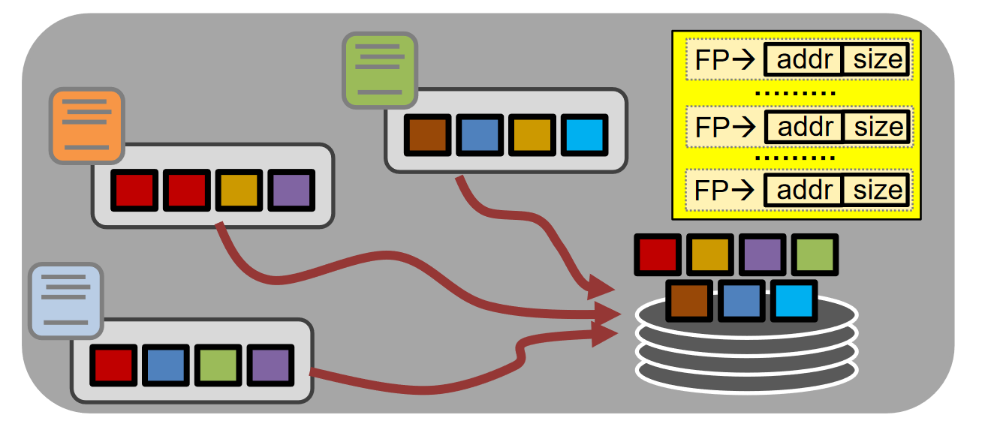
Data Deduplication
A space-efficient storage approach
• Unit: chunk (fixed-size or variable-size)
• Compute a fingerprint for each chunk (e.g., SHA-256)
• Manage fingerprint index to track stored chunks
• Store only one copy of duplicate chunks
• Achieve ~10x storage space savings in backup workloads [Wallace, FAST’12]
Notes:
在外包存储中聚焦的是数据去重的问题，一个空间高效的存储系统应该是满足这样的特性。当把文件按块划分时，存储系统中只会存唯一一份文件块。可以看一下这个图。那么现在的主流方案是怎样的呢？

Slide 4
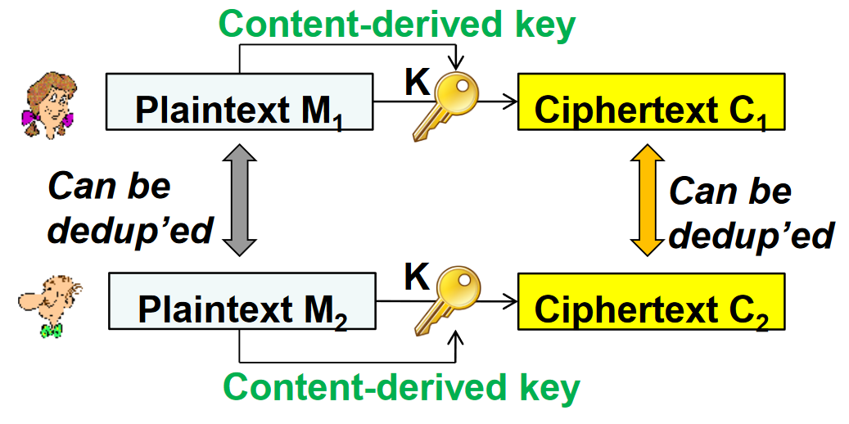
Deduplication-after-Encryption
Message-locked encryption uses a key derived from chunk content [Bellare, EuroCrypt’13]
Enable cross-user deduplication on ciphertext chunks
• e.g., Key = hash of plaintext chunk
Server-aided key management
• Deploy a key server to prevent brute-force attacks [Bellare, Security’13]
Notes:
目前的主流方案，是把数据加密之后，为了让加密后数据可以实现重复的效果，密钥需要与原文有关联，于是13年欧密会就有学者提出方案说要从原文中生成一个密钥，用这个密钥来做加密。

Slide 5
Limitations of DaE
High key management overhead
Storage: store a key for each chunk
Performance: key generation overhead is expensive [Ren, ATC’21]
Incompatibility with compression
Ciphertext chunks cannot be further compressed
Compression before encryption → leak compressed chunk lengths [Chen, SYSTOR’21]
Security risks
Single point-of-attack due to centralized server-aided key management
DaE is deterministic → vulnerable to frequency analysis [Li, EuroSys’20]
Notes:
加密后再去重不够高效局限性主要有
1.密钥管理开销大
2.与压缩不兼容:密文块无法进一步压缩
3.Security risks 密钥管理器被攻击

Slide 6
Deduplication-before-Encryption
Benefits over DaE by design
• Encryption can use content-independent keys (L1 addressed)
• Compression can be applied on non-duplicate plaintext chunks after deduplication (L2 addressed)
• Deploying a key server for key generation is unnecessary (L3 addressed)
how should deduplication be protected?
Notes:
好处主要有：
1. 加密可以使用与内容无关的密钥
2.去重后可以对非重复的明文块应用压缩
3.无需为密钥生成部署密钥服务器

Slide 7
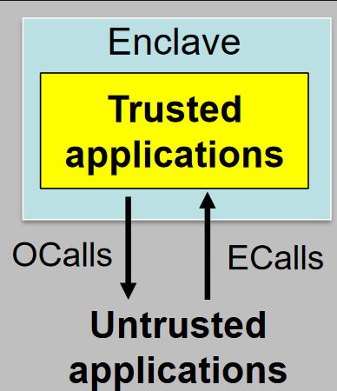
Intel SGX Basics
Enclave: secure memory region realized by Intel SGX
OCalls and ECalls to interact with untrusted applications
SGX limitations in performance
• Enclave page cache (EPC) has limited size (e.g., 128 MiB)
• Exceeding EPC size → expensive EPC paging overhead
• ECalls and OCalls lead to context-switching overhead
Challenge: How to mitigate SGX overhead in DEBE?
Notes:
于是可以想到用可信执行环境来做 用intel SGX来说，可信区只有128MB，
因此不能把数据全部放进去进行去重，
同时频繁的可信与不可信区上下文切换将会产生很大的开销，
因此如何减轻 DEBE 中的 SGX 开销成为了一个挑战挑战：如何减轻 DEBE 中的 SGX 开销？

Slide 8
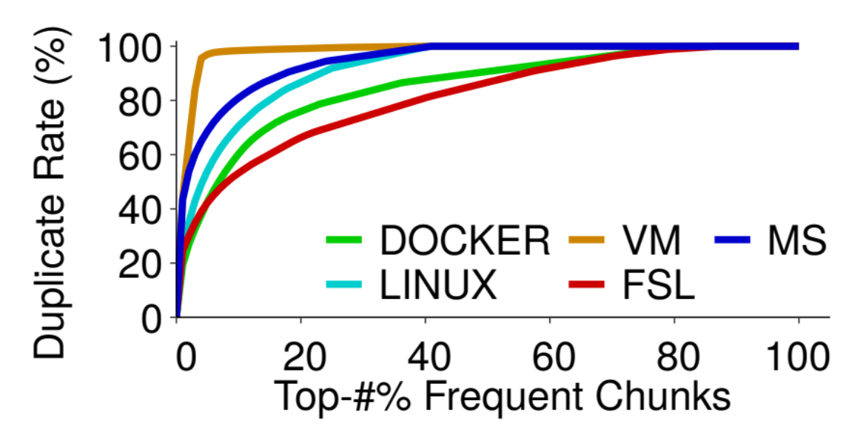
Main Idea
A small fraction of top frequent chunks contribute a large fraction of duplicates
• In VM, top-5% of frequent chunks contribute to a duplicate rate of 97%
Frequency-based deduplication: separate deduplication process in two phases based on chunk frequencies
• First phase: Manage small fingerprint index in enclave to remove most duplicates → mitigate EPC paging overhead
• Second phase: Manage full index out of enclave to remove remaining few duplicates → reduce context-switching overhead
Notes:
作者在现实世界的5种备份数据中做了一个统计，发现一小部分的数据块贡献大部分的重复存储，这无疑是占用了一大部分的存储空间
于是作者提出了一种基于频率的去重方案，分为两个阶段，在第一个阶段中管理一小部分频率较高的索引，第二阶段处理剩余频率较低块的索引。分两阶段实现去重

Slide 9
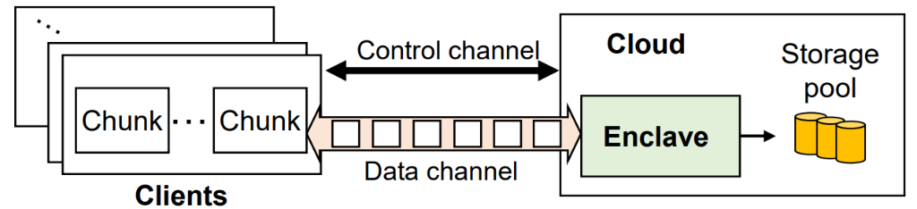
Overview
Target-based deduplication
• Protect DbE via Intel SGX
• Perform deduplication and compression over plaintext chunks in enclave
Communication
• Control channel: transmit commands for storage operations
• Data channel: transmit plaintext chunks to enclave
• Protected by a short-term session key shared by a client and enclave
Notes:
这是系统的整个系统架构，用户与服务端用一个data channel来交互，核心的业务逻辑处理在enclave中，在这个方案中，只需要用到两个key，一个是sessionkey，这个key是用来保证channel安全的，用密钥交换算法可以实现key的安全
第二个key是

Slide 10
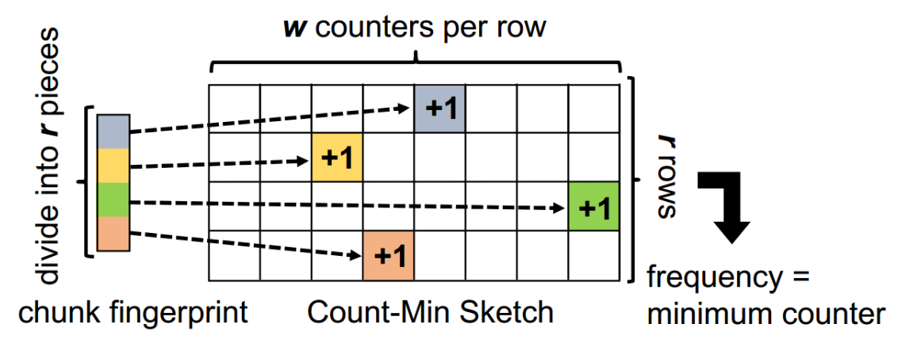
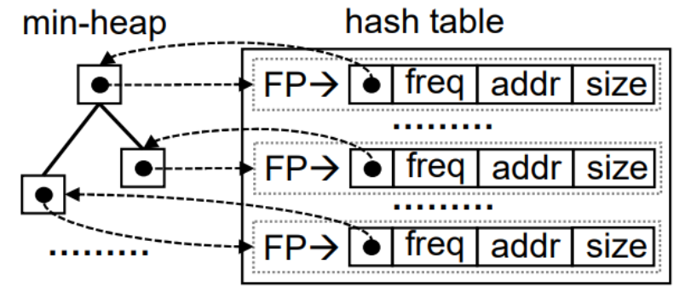
Frequency Tracking and Deduplication
Count-Min Sketch (CM-Sketch) to track approximate frequency of each chunk
Use min-heap and hash table to manage tok-k index
Notes:
这里介绍一下主要用到的处理方法，第一个是对于

Slide 11
engineering improvement
Current problems:
SDK and PSW compile time too long (30mins pretry)
Not conducive to rapid deployment and testing
Multiple dependencies on different cryptographic sgx-related-libraries
dependencies are complex, High coupling
Operating system sensitive
Configuration needs to follow different rules
Notes:
在复现的过程中，我发现目前存在着以下问题
第一点是环境的搭建十分复杂，SDK与PSW每一次的编译时间需要30分钟，并且安装具有一定的依赖关系
第二点是项目依赖着intel 的sgxssl库，不同版本sgxssl依赖着不同版本的openssl，这样有很高的耦合性
第三点是不同的系统有着不一样的配置规则

Slide 12
engineering improvement
For better experimental setup
containerized startup
Services can be scheduled by k8s, which is more in line with engineering deployment
Docker volume
AESM
SDK APP
Notes:
Docker 可以提高应用程序的可移植性，并提供一种轻松的方法来管理和运行应用程序。
最后我把整个SGX服务拆为两个，一个AESM容器，一个是应用容器。 Intel SGX Attestation Service Manager（AESM）的服务。
它是一个运行在操作系统中的守护进程，负责提供对 Intel SGX 硬件功能的访问。它可以检测 Intel SGX 硬件是否存在，并且可以协助应用程序与硬件通信。AESM 还可以协助应用程序进行身份验证，以确保应用程序是合法的。
应用容器中安装了sdk与psw与所需要的特定版本的密码学库。
为了实现容器间互通，aesm与应用容器通过一个新建的docker volume 来共享aesm socket。 由此服务能运行在任何支持SGX服务的芯片的机器上。并且可以使用k8s的容器编排功能对容器进行资源调度。真正意思上实现一个安全云存储的工程化改造。

Slide 13
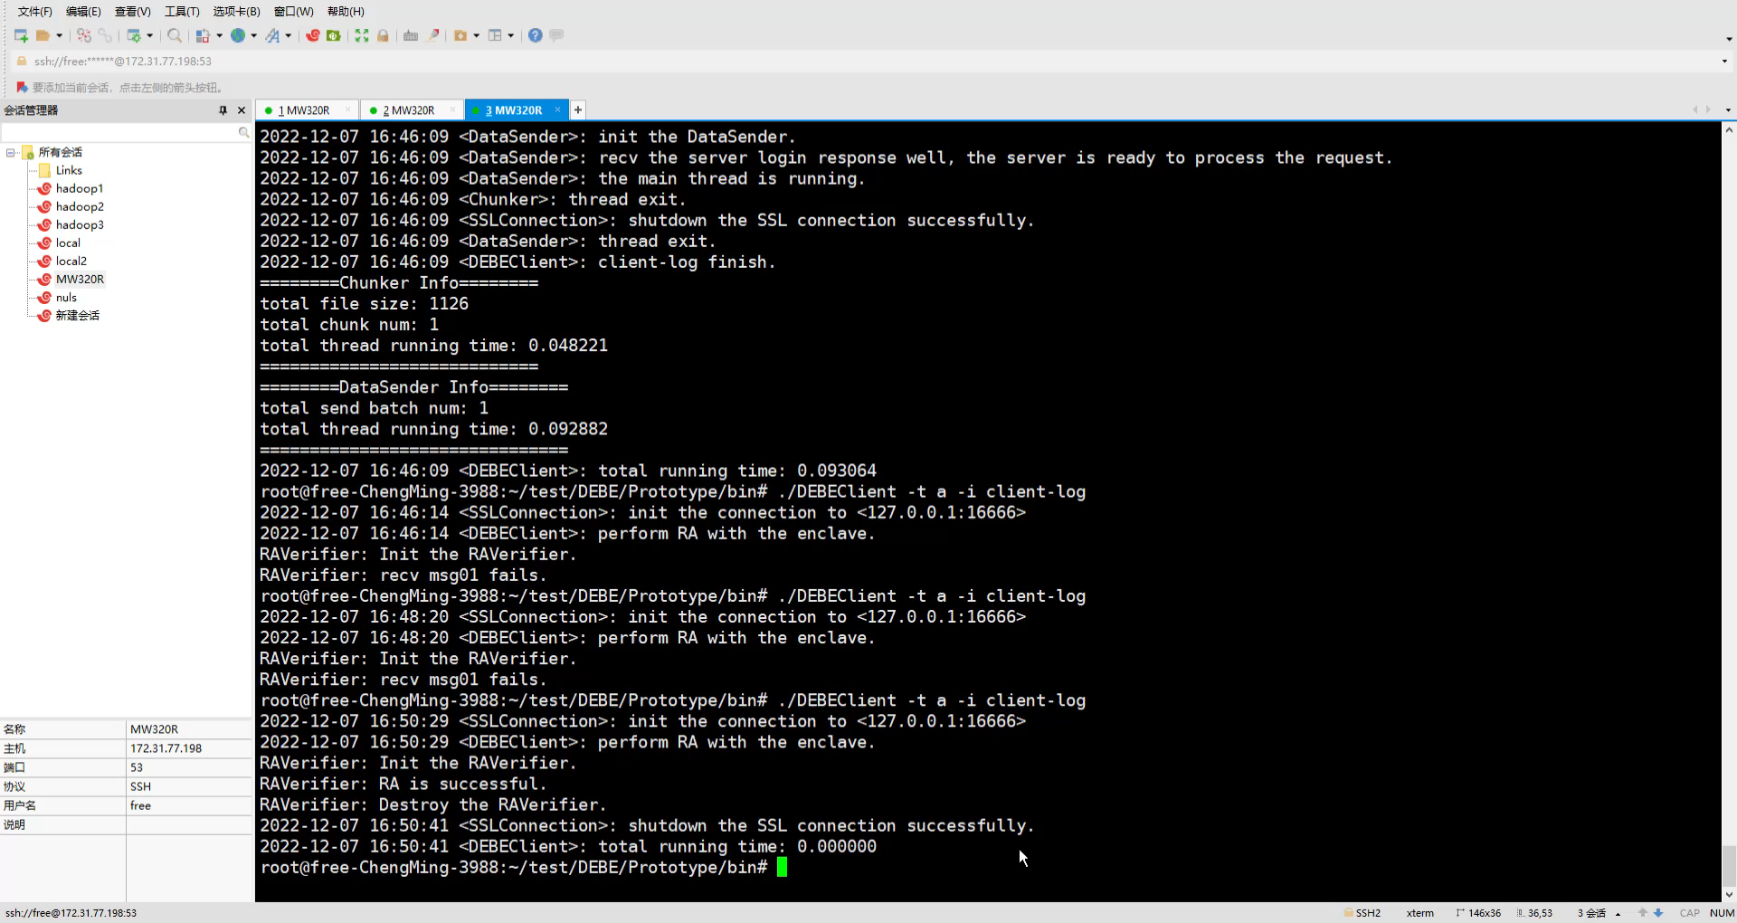

Slide 14
Conclusion
DEBE realizes DbE via Intel SGX
Perform deduplication and compression in enclave
Apply frequency-based deduplication
Outperform DaE approaches in performance, storage, and security
Source code: https://github.com/yzr95924/DEBE
• Received all three artifact badges
Docker images:registry.cn-hangzhou.aliyuncs.com/zhanghaohui/sgx: 01
registry.cn-hangzhou.aliyuncs.com/zhanghaohui/aesm: 02

